Slide 1
Class
1
September 2024
About us
Welcome to
Parents
Teacher
LSA
What we need from you
Tests
Key information
Baseline, Phonics, MTC, SATs
Spelling
Reading
PE
And more!
Our learning
Topics this year

Slide 2

About us
Class Teacher
Mrs Mercer
LSA
Mrs Warren
Mrs Saunders

Slide 3
Key info to remember
Timings of the school day
Gates open at 8:30 and close at 8:40. After 8:40 your child will be marked as late. After 9:00 lateness will be recorded as unauthorised absence. School finishes at 3:10.
Importance of punctuality
It may not seem like a big problem, but our learning time is tight. We like to pack in as much as we can, every single day. Arriving just a few minutes late can mean your child misses: phonics, reading support, spelling interventions, core skill practice.

Slide 4
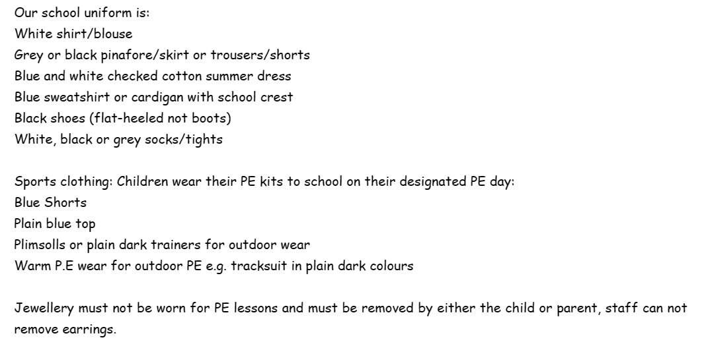
Key info to remember
PLEASE NAME ALL UNIFORM! (especially cardigans and jumpers).
Uniform and jewellery: Uniform Information | Gosfield Community Primary School (gosfield-pri.essex.sch.uk)

Slide 5
Key info to remember
Uniform and jewellery: Uniform Information | Gosfield Community Primary School (gosfield-pri.essex.sch.uk)
Jewellery should be limited to stud earrings. All other jewellery should be limited, unless for religious reasons.
Jewellery should not be worn for PE and earrings must be removed before PE lessons- staff are not able to remove earrings and we are not able to provide tape to cover them.
Do not get ears pierced in term time as your child will miss their PE lessons.

Slide 6
Key info to remember
Term time holidays
We need your child in school!
As a school our policy on term time holidays is provided by Essex County Council. There are very few situations where holiday is approved.
Any unauthorised holidays may result in a fine.

Slide 7
Breaktime and Lunchtime
Snacks and Lunches
ALL children in KS1 are provided with a free school meal at lunchtime, subsidised by the government. If your child would prefer a packed lunch please provide this for them.
Children can bring their own healthy snack (fruit or veg only). The school also has free fruit for your child to eat at breaktimes too. Please do not send chocolate bars or crisps for a breaktime snack.

Slide 8
Important days for Class 1
PE days – our PE day this half term will be on a Thursday afternoon from 1-2.
Spellings (for Year 1 ONLY) set each Friday and tested each Friday, commencing the second week back.
Reading records checked each Thursday- we expect a minimum of 3 reads at home each week.

Slide 9
Our topics this year:
Autumn 1 – Dinosaurs
Autumn 2 – People and Places
Spring 1 – Local History
Spring 2 – All About Africa
Summer 1 – Walking on the Moon
Summer 2 – Under the Sea

Slide 10
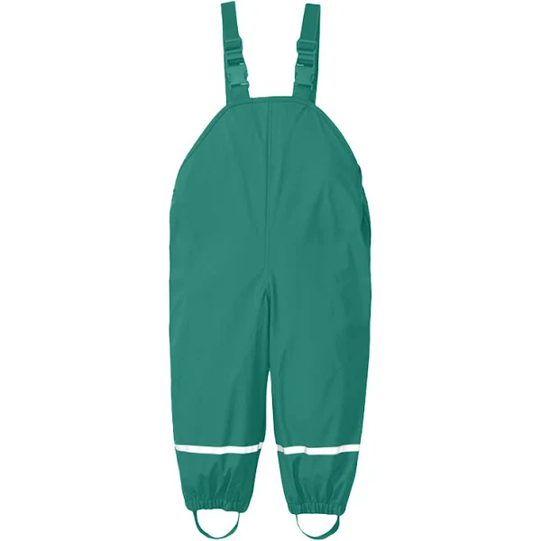
Our learning this year
For reception children outside:
If you are able to provide a set of wellies and some waterproof trousers/waders as the children will be accessing learning outside in ALL weathers.

Slide 11
Tests and checks for Class 1
Reception Baseline Assessment
This is a government assessment for all children in Reception within their first 6 weeks of starting school. It covers basic maths and comprehension.
Year 1 Phonics Screening Check
An assessment consisting of 40 words (real and pseudo). It is a check to see whether children can decode words successfully. Children who do not reach the pass mark in Year 1 will complete it again in Year 2.

Slide 12
Reading Diaries
Yellow Reading Diary
A way of keeping track of reading at school and at home. If you read to your child or they read to you, even if it is bedtime reading – please write it in the diary as it all counts!
Sound Pouch
Each week a new set of sounds will be in the pouch. We will learn them during the week at school. If you could practise them as often as possible at home that would be great!

Slide 13
Parents- What we need from you
Check emails, website for updates:
https://www.gosfield-pri.essex.sch.uk/
PLEASE read at home a minimum of 3 times a week
Parent Conduct-
We’re all human and no-one is perfect; there may be a time when something happens that you aren’t clear about or would like to discuss.
Come and speak to us and please remember; our staff do not come to work to be verbally assaulted.
We all want the best for your child, let’s do it as a team.

Slide 14
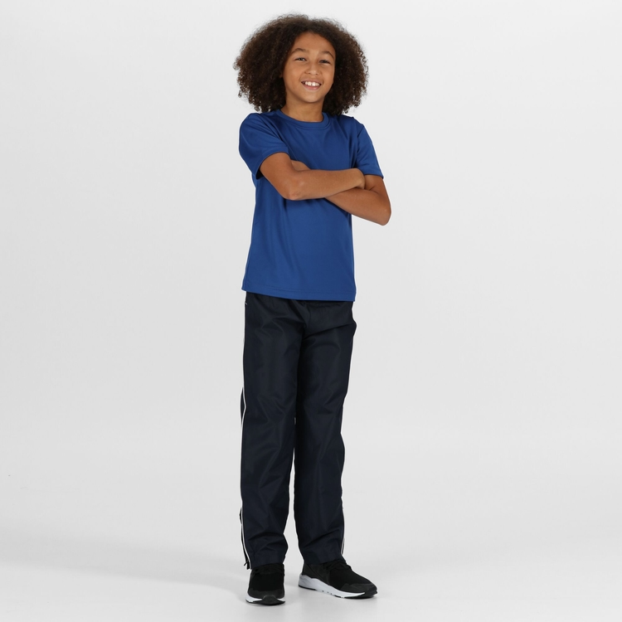
Parents- What we need from you
A change of clothes every day
The children are enjoying the outside area so much that sometimes they forget to go to the toilet or don’t reach it in time, we also do get wet and messy so may need to change our tops or trousers sometimes.
Could you please provide a spare change of clothes in their bag each day so we can change them quickly and easily so they can get back to enjoying their learning!

Slide 15
Any Questions?
No question is a silly question!

